Slide 1
Assessing Soil Quality and Heavy Metal Pollution in the Gas Blowout Area of Tengratila Gas Field, Chattak, Bangladesh: A Multivariate Statistical Approach and Heavy Metal Pollution Indices Analysis
Submitted by :
Arovin Al Nayem
2017336027
Under the supervision of :
Md. Abdullah Al Numanbakth
Assistant Professor
Department of Petroleum and Mining Engineering

Slide 2
Introduction
Soil is a valuable natural resource, a requirement for all life, and a prime natural resource. The presence of heavy metals in soil poses a threat. Heavy metal not only affects the soil quality but also affects human health condition.
Tengratila gas field was a great resource of Bangladesh situated near Dowarabazar upazila. However, The tengratila gas field sadly caught fire twice due to explosions on January 5 and June 24 of 2005, when Canadian gas firm Niko was drilling in the well. It had alter the soil properties around the gas field regions

Slide 3
To determine the common chemical parameter of soil and interpret their concentrations.
To evaluate the quality & contamination level of the soil
To assess the heavy metal concentration around the study area.
To calculate different heavy metal pollution indices values for assessing the heavy metal pollution in the blowout region
To find out the contamination source and possible impact of the blowout
Objective of
the
Study

Slide 4
Methodology
Sample Collection
Analysis
Pearson
Correlation
Chemical Analysis
Statistical Analysis
Cluster
Analysis
General Analysis
Spatial interpolation map
Soil quality indices
Factor Analysis(PCA)
Metal Index
Geo-accumulation index
RI Index
Single Factor and
Nemerow index
Pollution
Load index

Slide 5
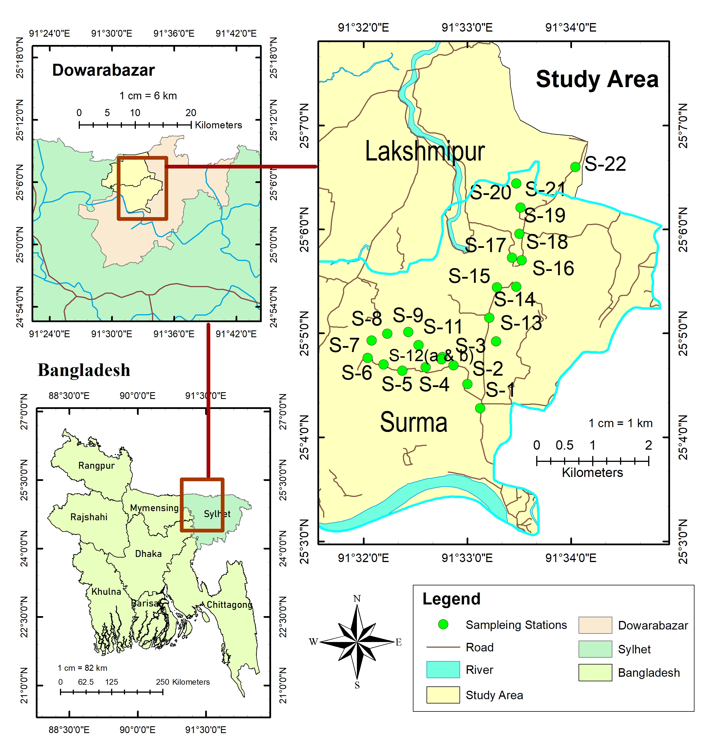
Sample Collection

Slide 6
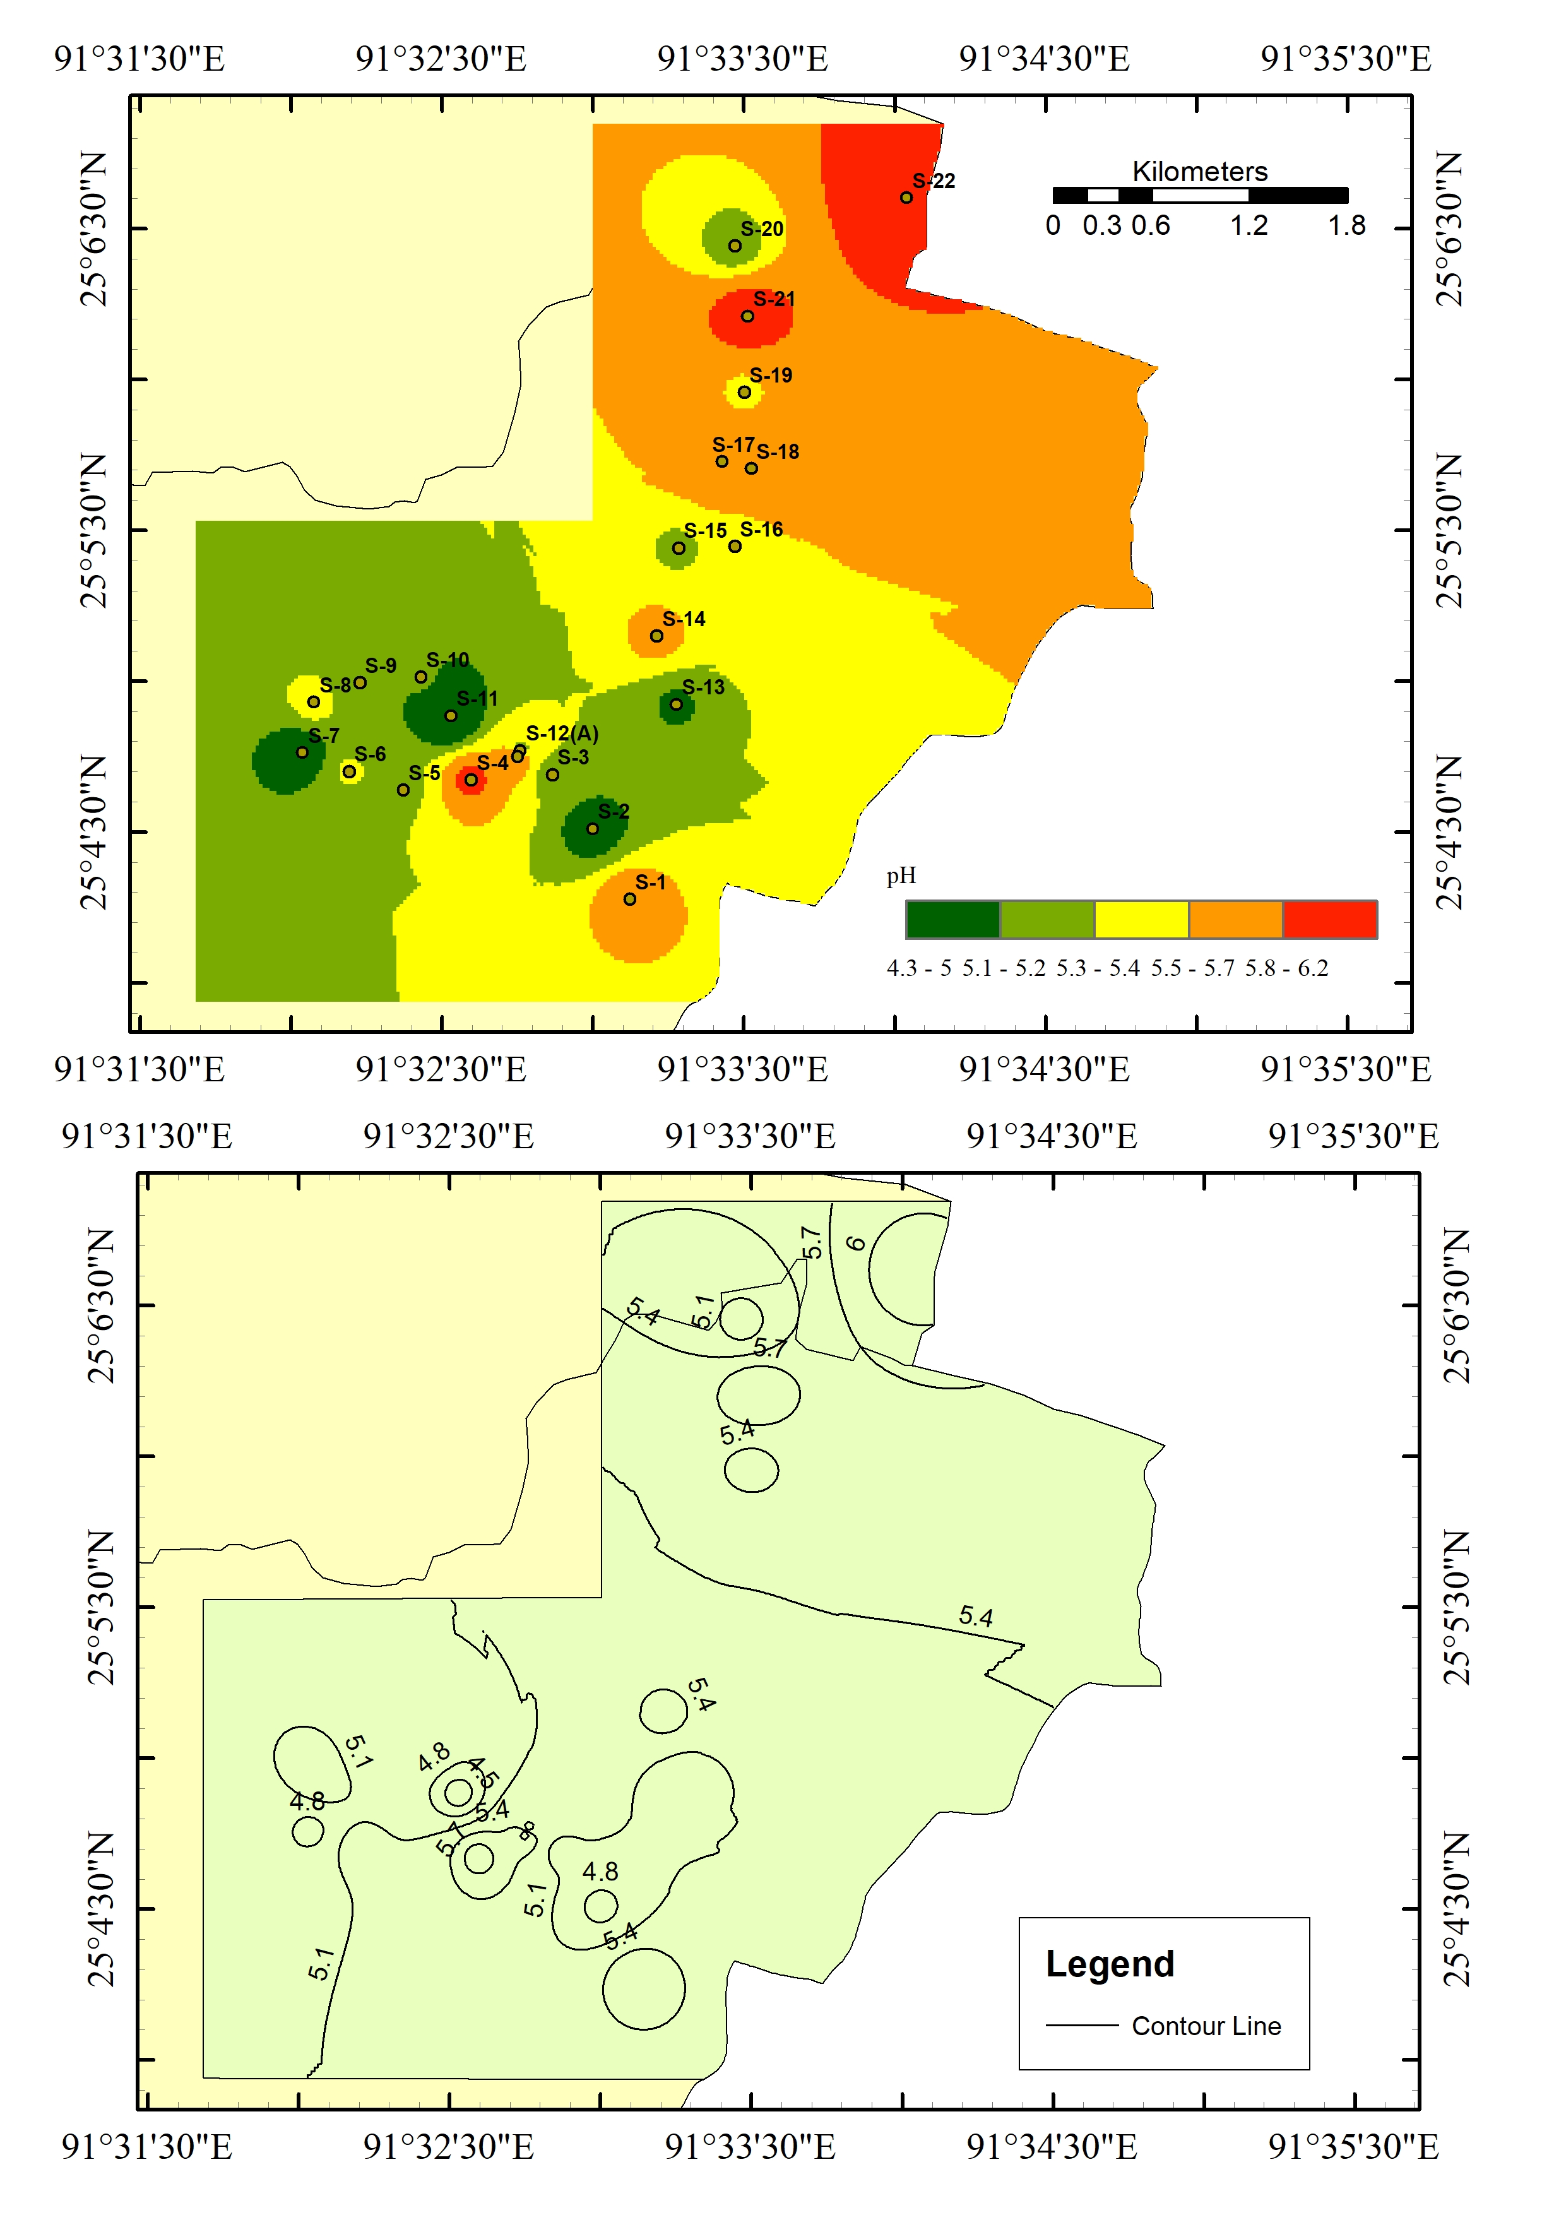
Result and Discussion
pH
Permissible limit of pH is 6 -7.5
Max = 6.2
Min = 4.3
Average = 5.28

Slide 7
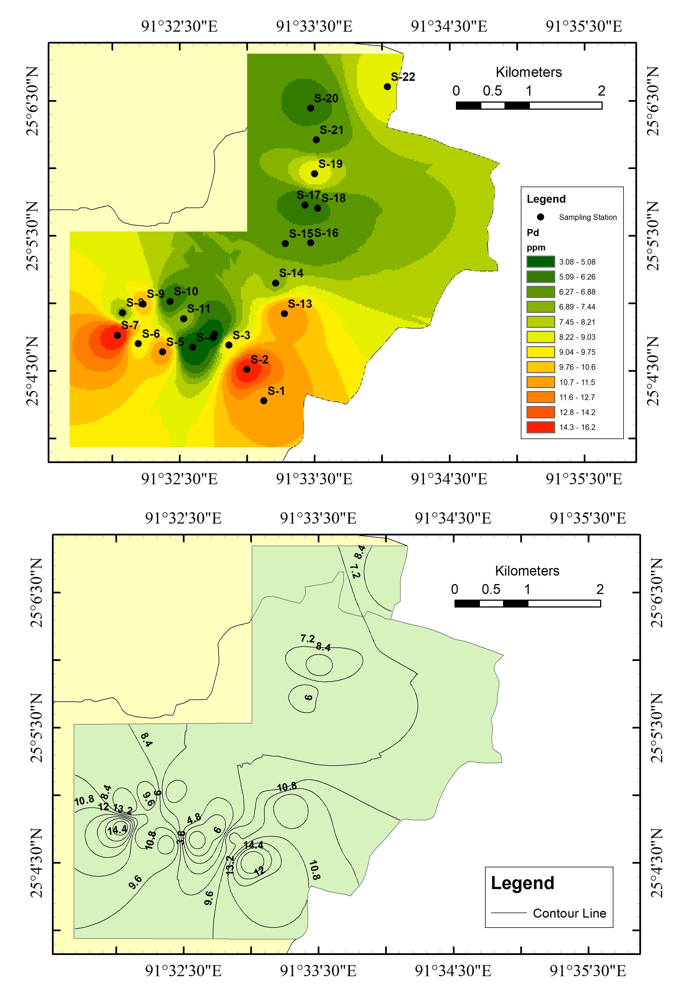
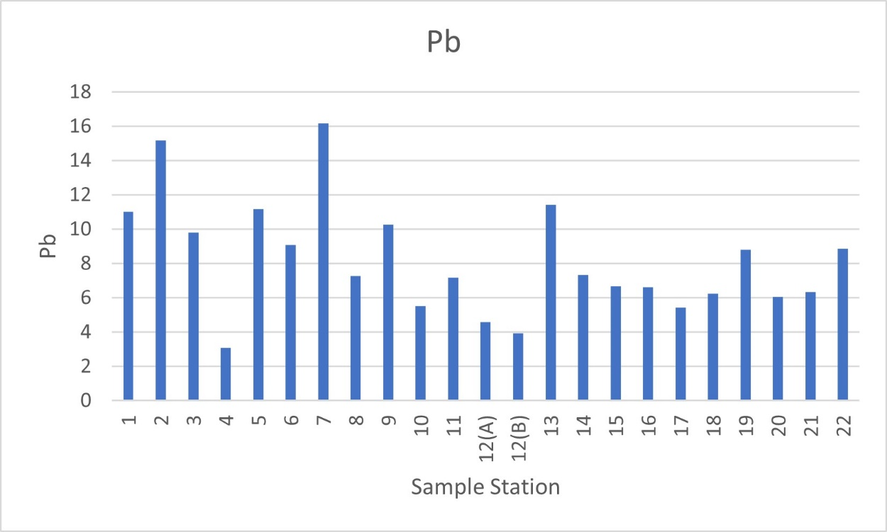
Result and Discussion
Lead
Permissible limit of pH is .3 – 10 ppm
Max = 16.17
Min = 3.08
Average = 8.17

Slide 8
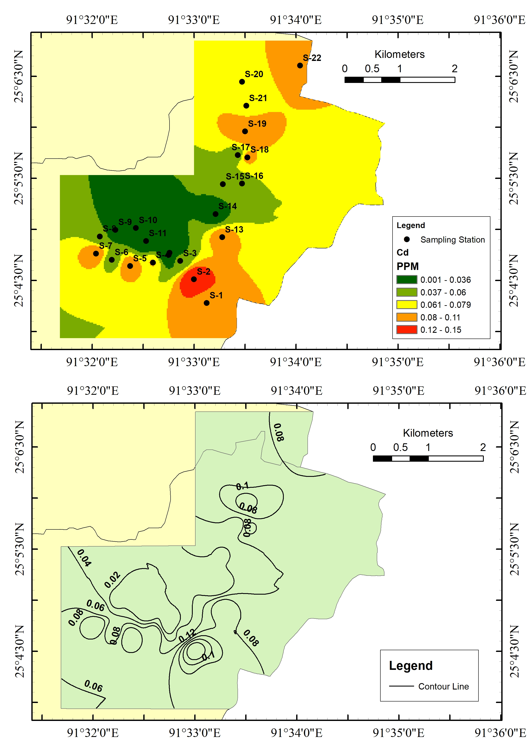
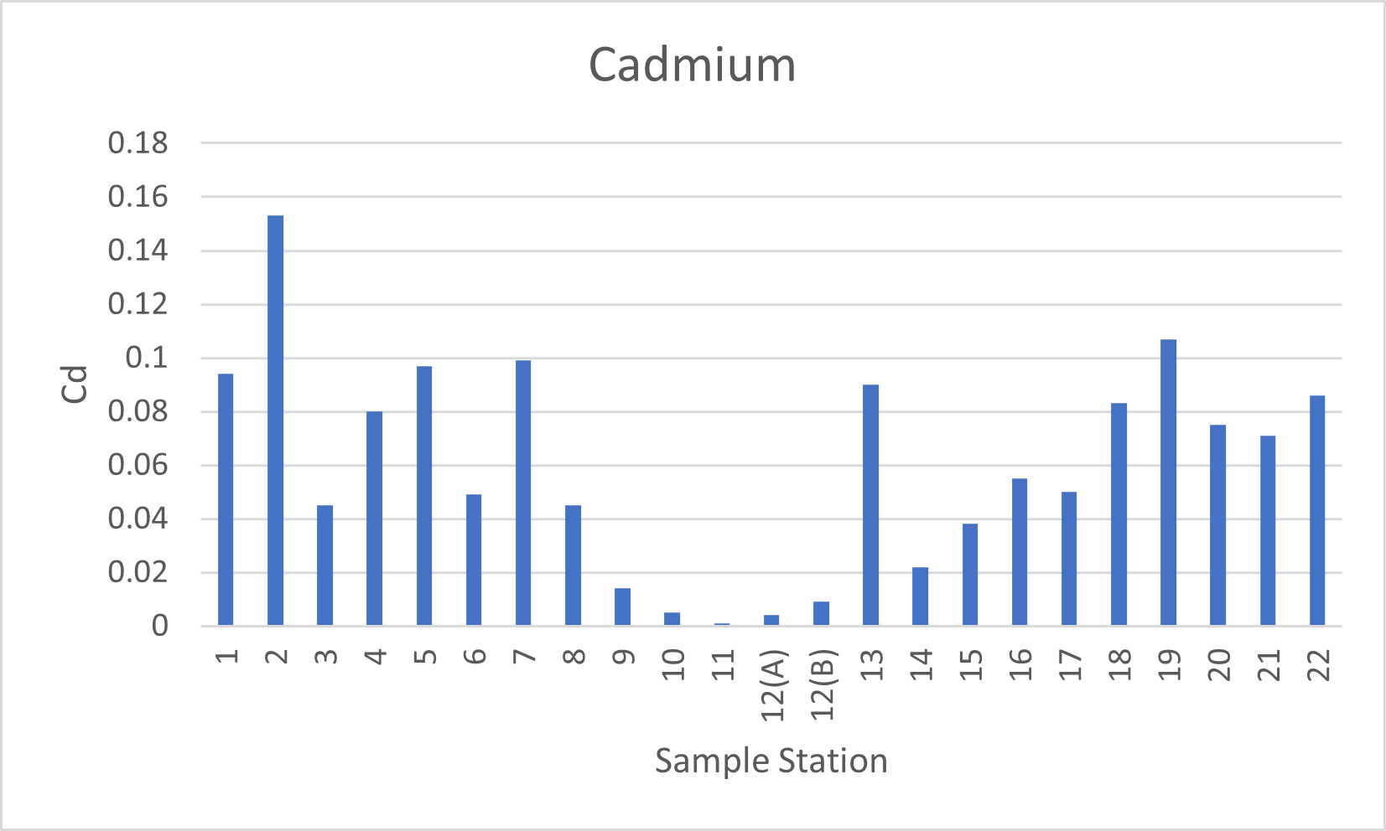
Result and Discussion
Cadmium
Permissible limit of Cd is .002 - .5 ppm
Max = 0.153
Min = 0.001
Average = 0.06

Slide 9
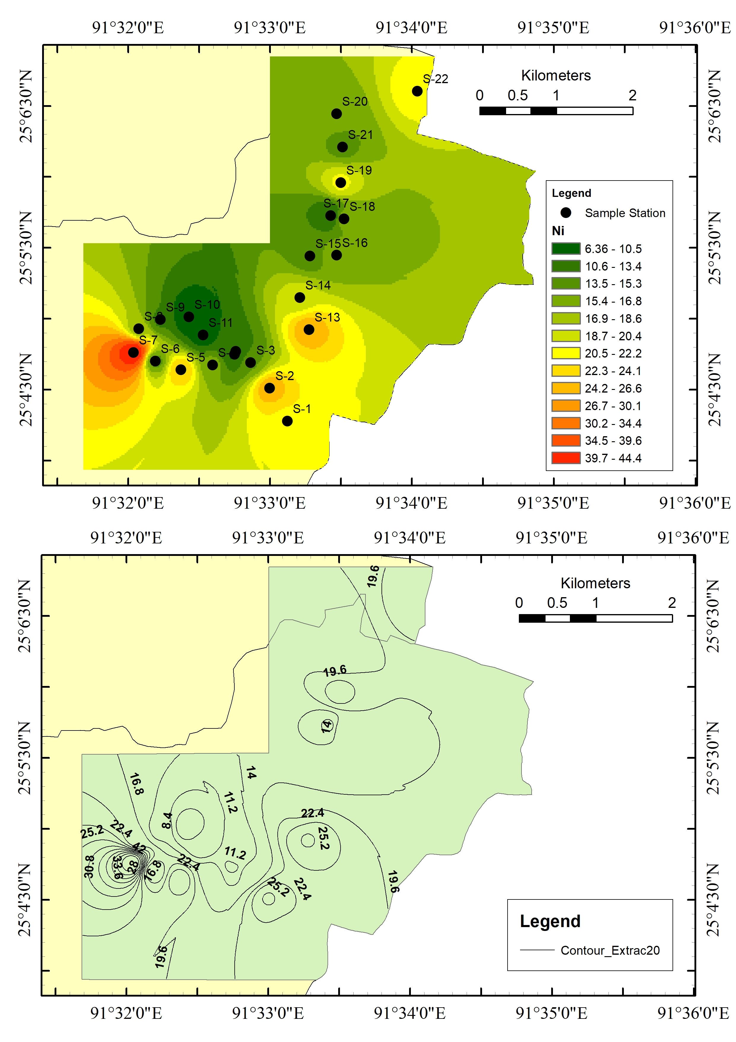
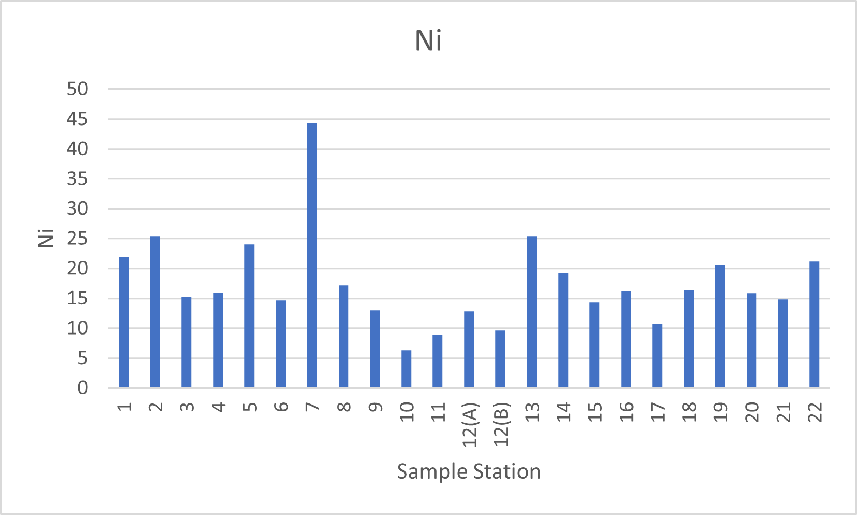
Result and Discussion
Nikel
Permissible limit of Ni is .1 – 5 ppm
Max = 44.37
Min = 6.36
Average = 17.58

Slide 10
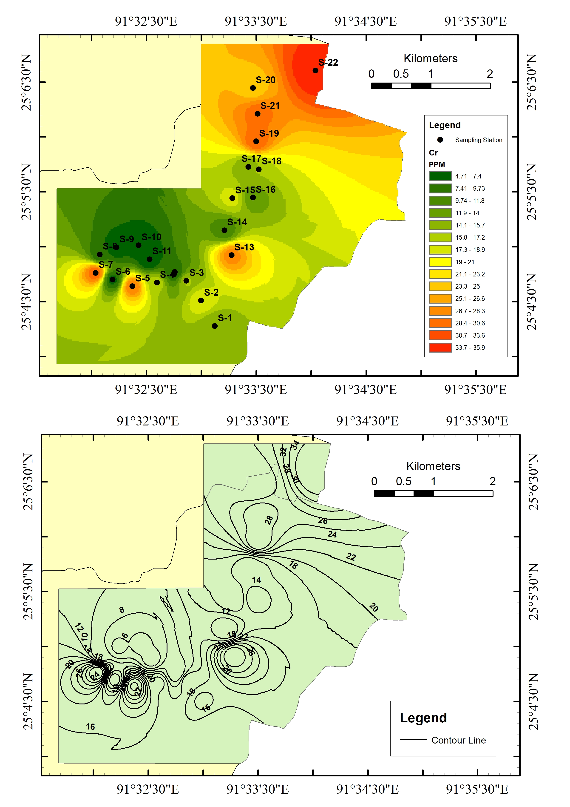
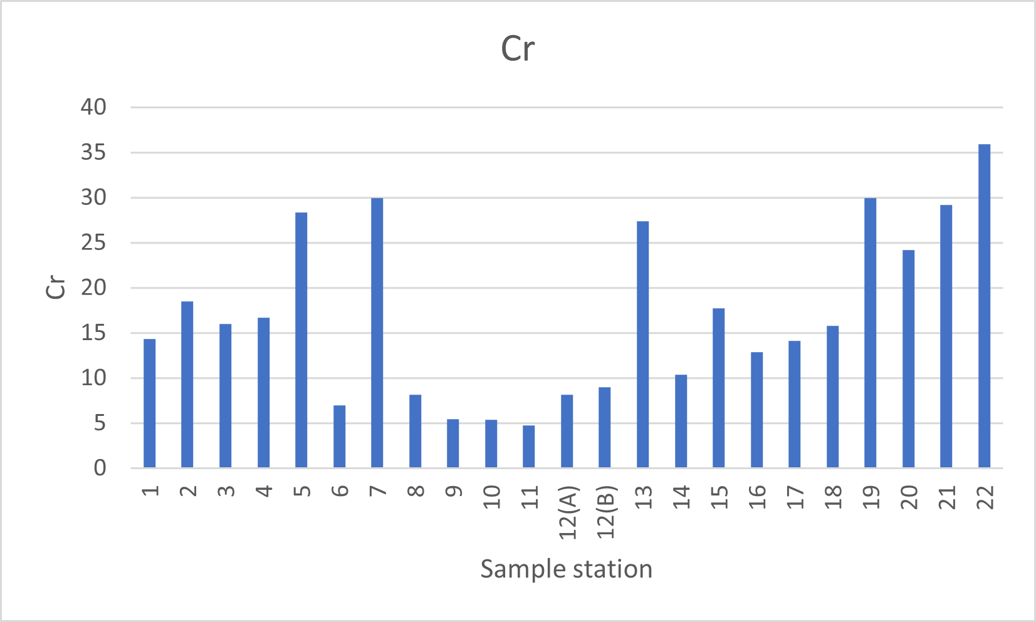
Result and Discussion
Chromium
Permissible limit of Cr is .002 - .2 ppm
Max = 35.94
Min = 4.71
Average = 16.90
.06

Slide 11
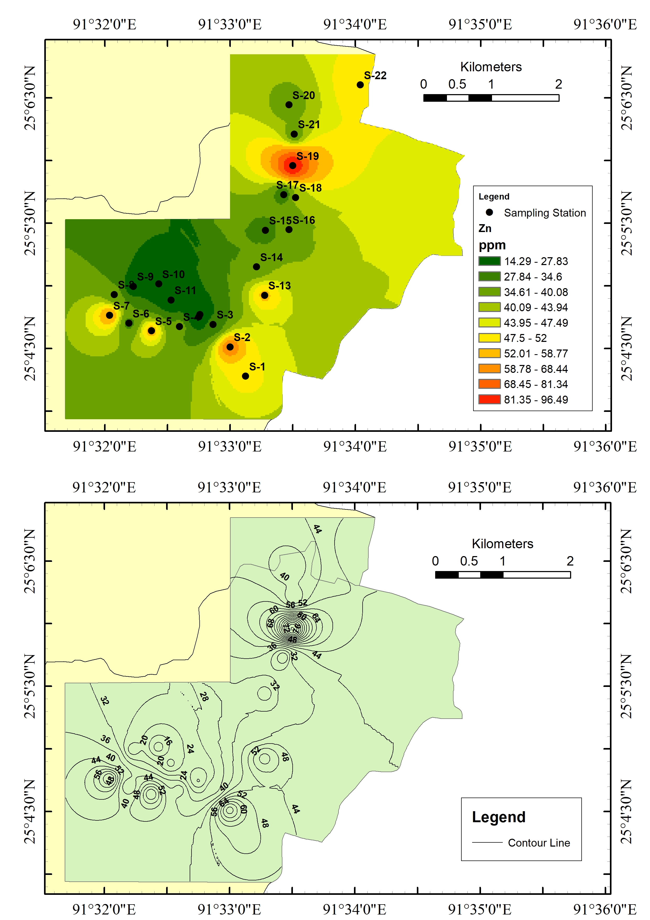
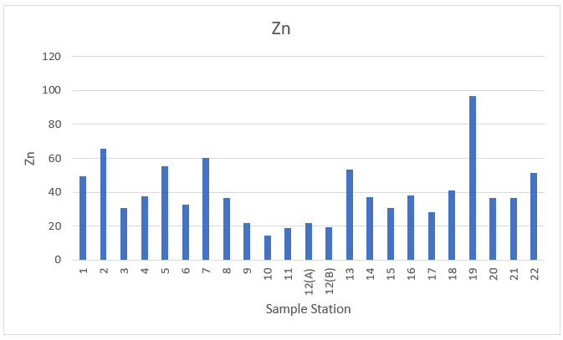
Result and Discussion
Zine
Permissible limit of Zn is .002 - .2 ppm
Max = 96.62
Min = 14.24
Average = 39.78

Slide 12
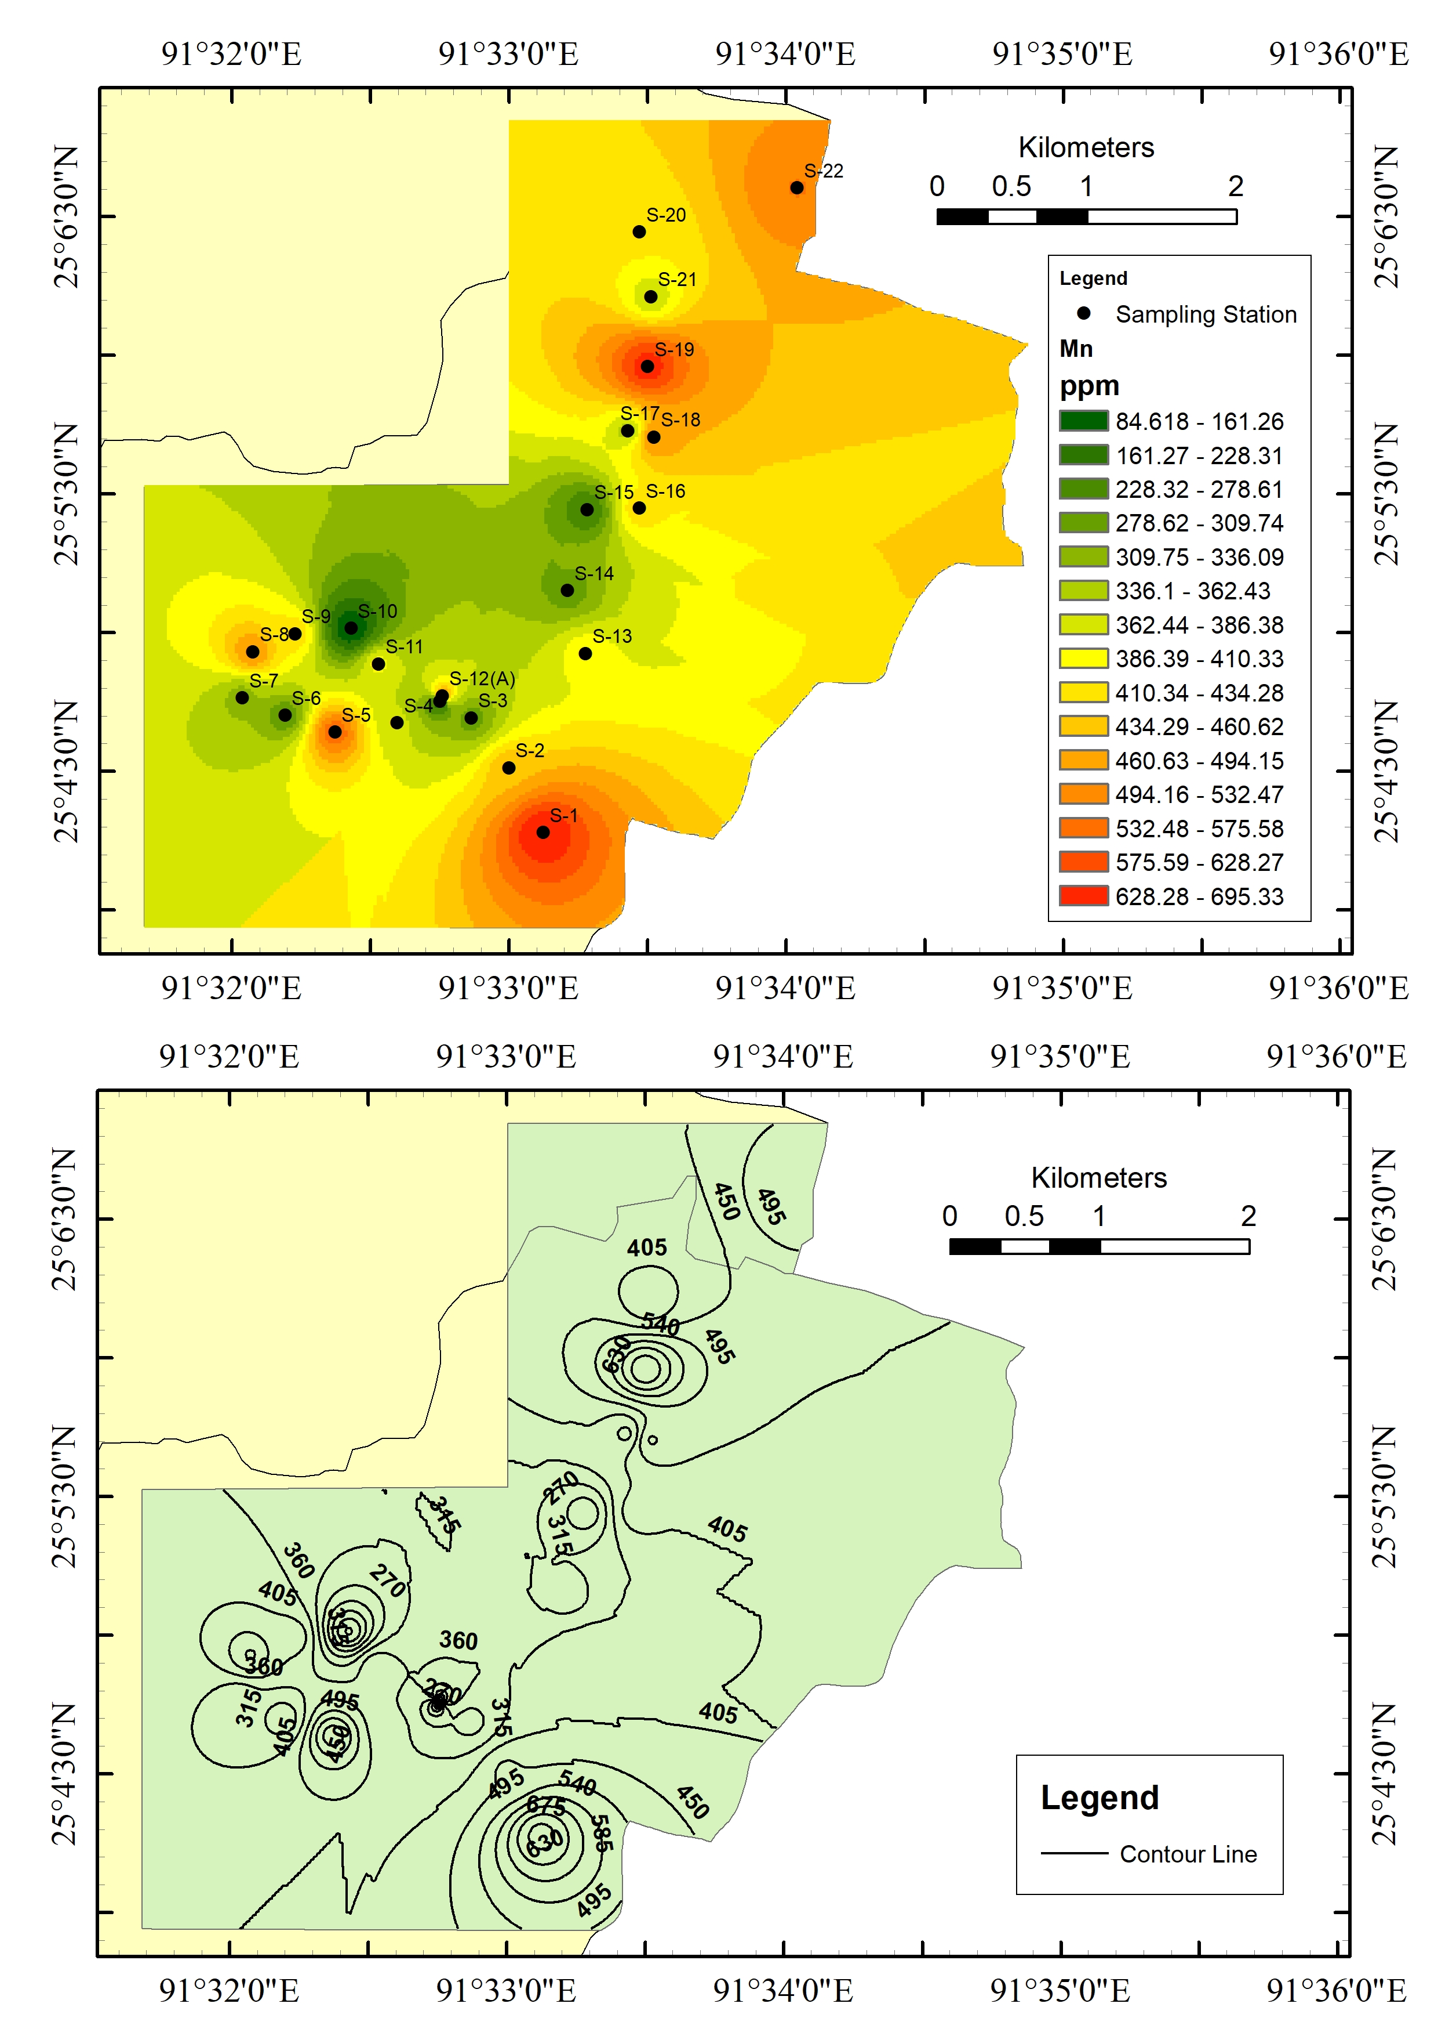
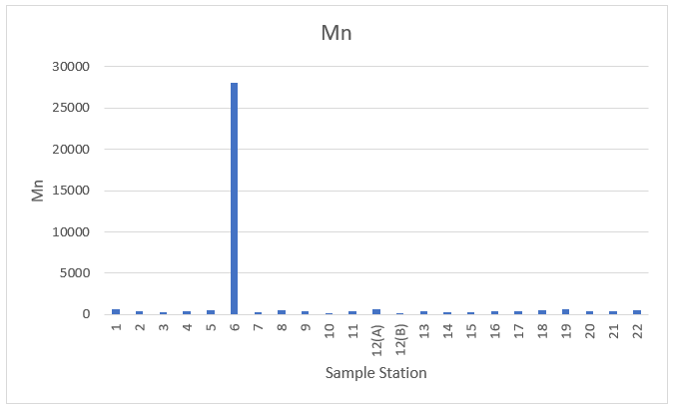
Result and Discussion
Manganese
Permissible limit of Mn is 500 mg/Kg
Max = 695.36
Min = 83.53
Average = 403.45

Slide 13
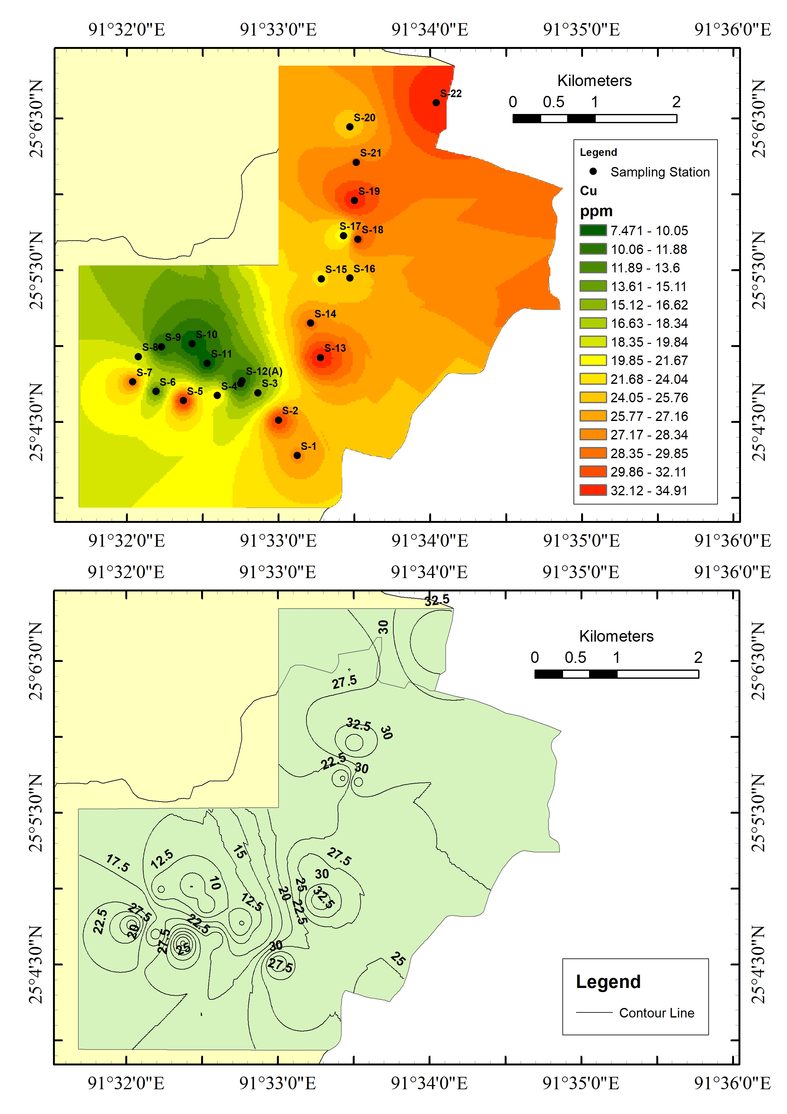
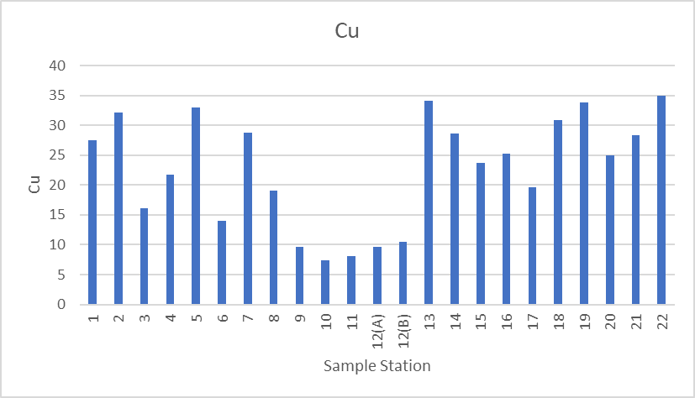
Result and Discussion
Copper
Permissible limit of Cu is 1-12 mg/Kg
Max = 34.91
Min = 7.45
Average = 22.68

Slide 14
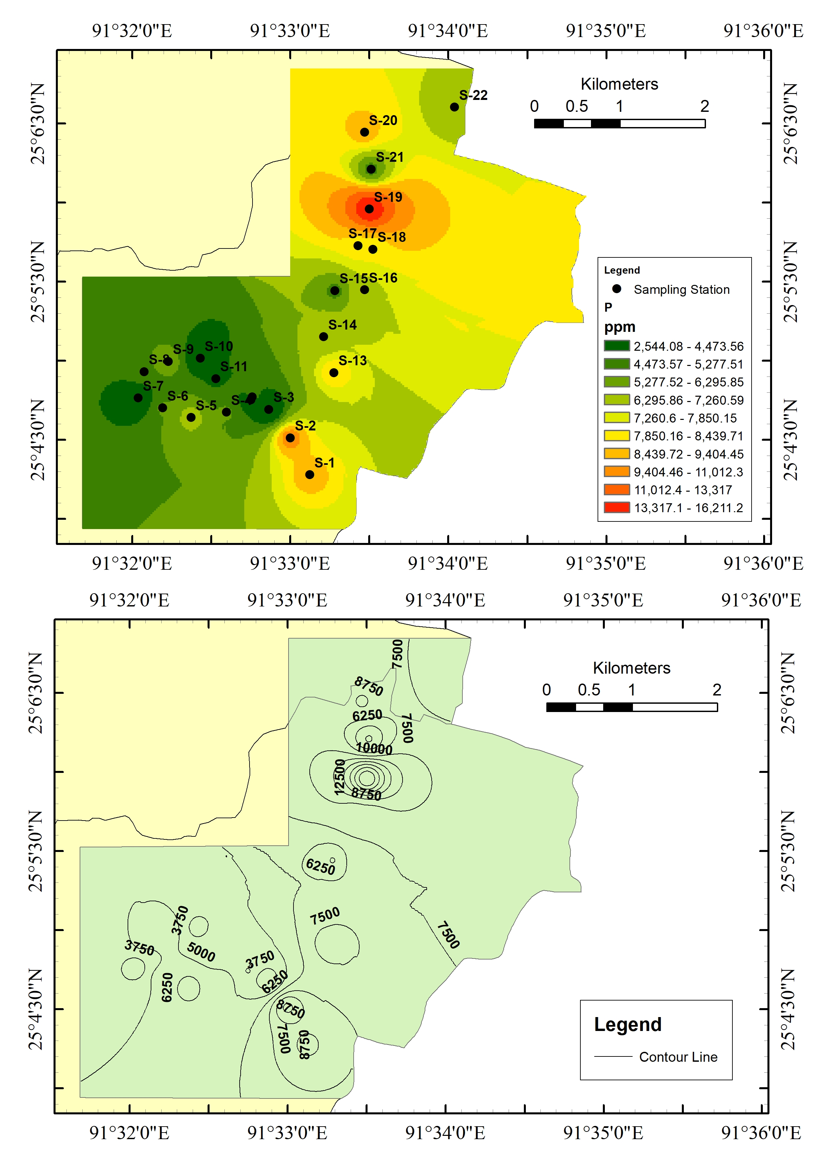
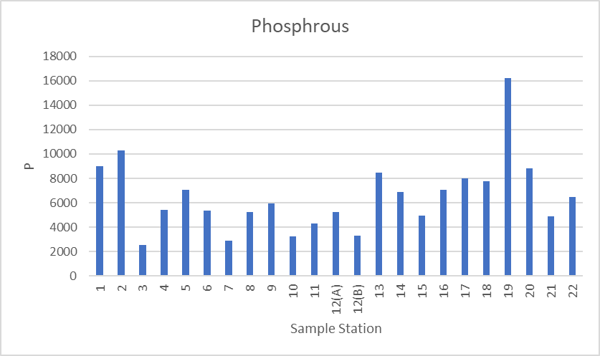
Result and Discussion
Phosphrous
Permissible limit of P is 200 - 1500 mg/Kg
Max = 16231.25
Min = 2537.5
Average = 6498.37

Slide 15
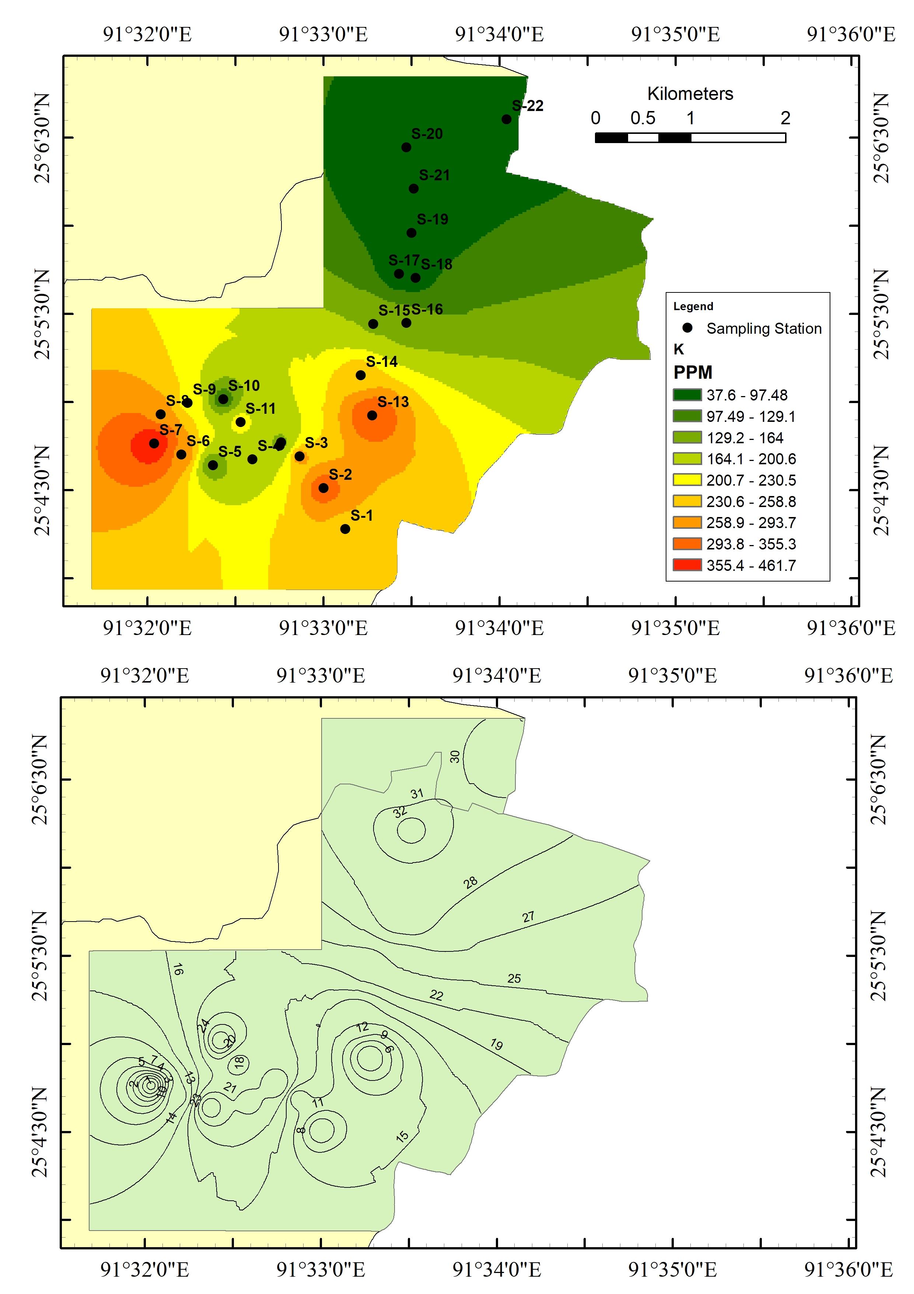
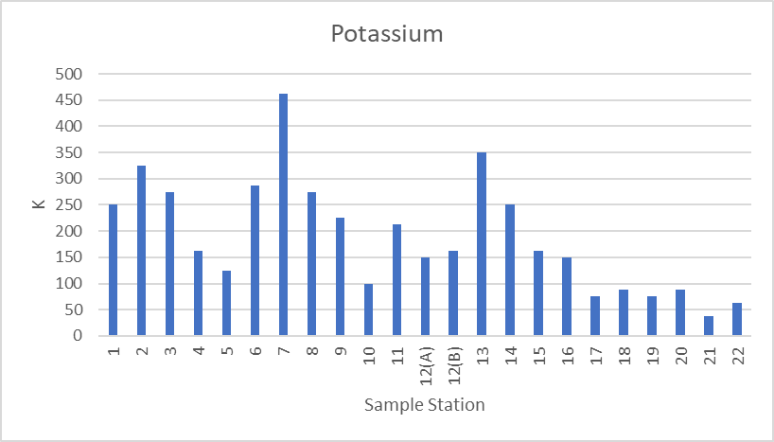
Result and Discussion
Potassium
Permissible limit of K is 180 - 300 mg/Kg
Max = 462.5
Min = 37.5
Average = 189.13

Slide 16
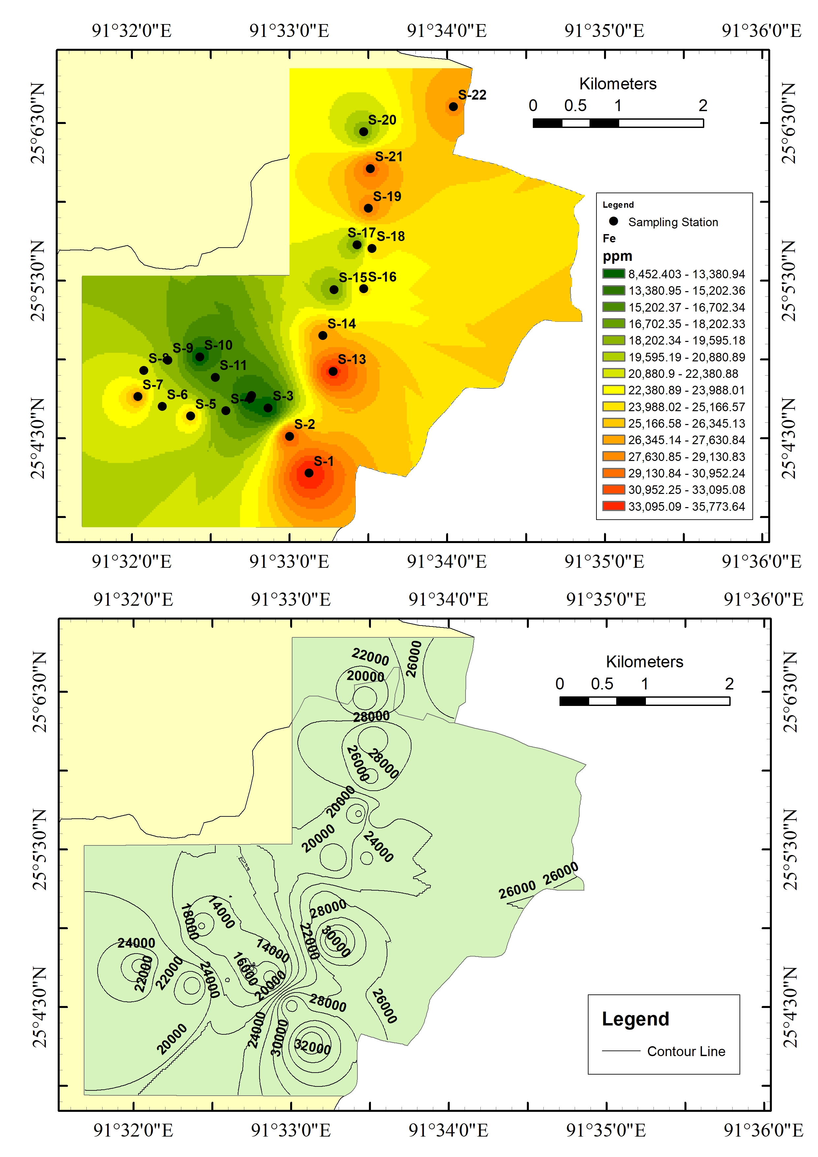
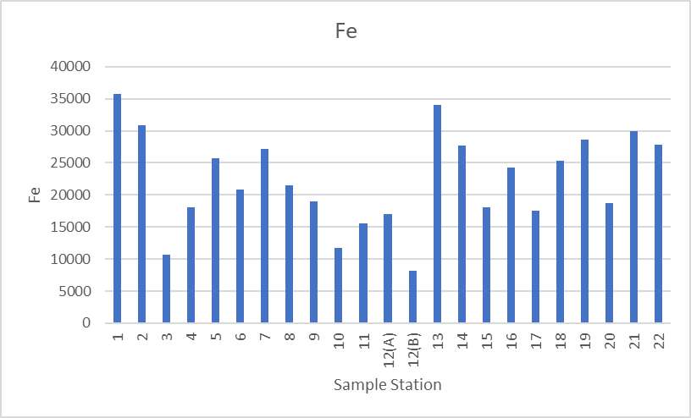
Result and Discussion
Iron
Permissible limit of Fe is 50 - 5000 mg/Kg
Max = 35575
Min = 8100
Average = 22342.39

Slide 17
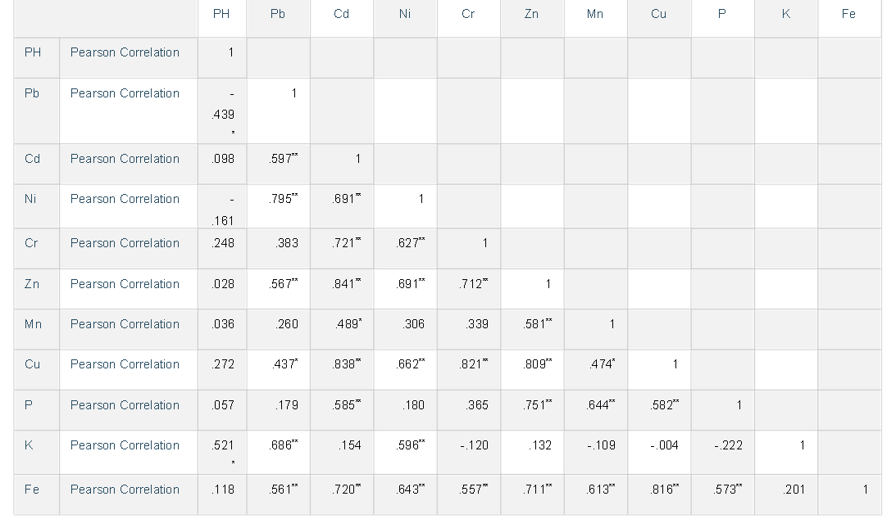
Pearson Correlation

Slide 18
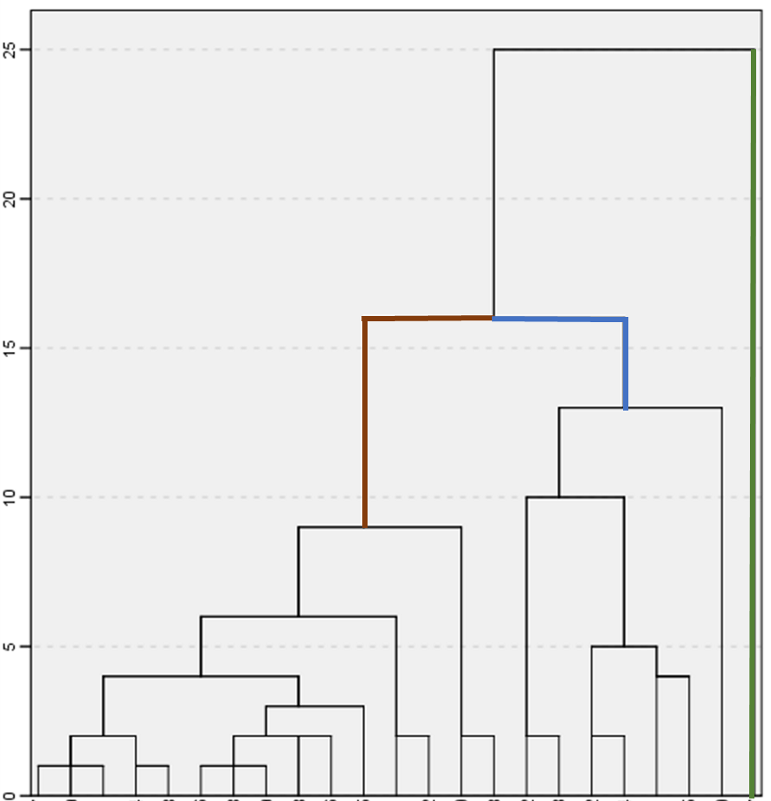
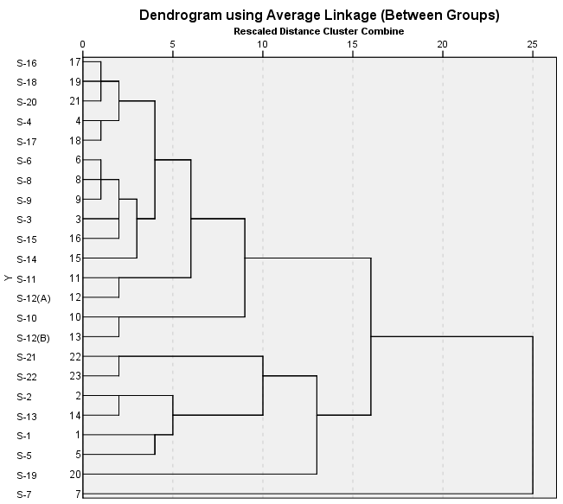
Cluster Analysis

Slide 19
Cluster Analysis

Slide 20
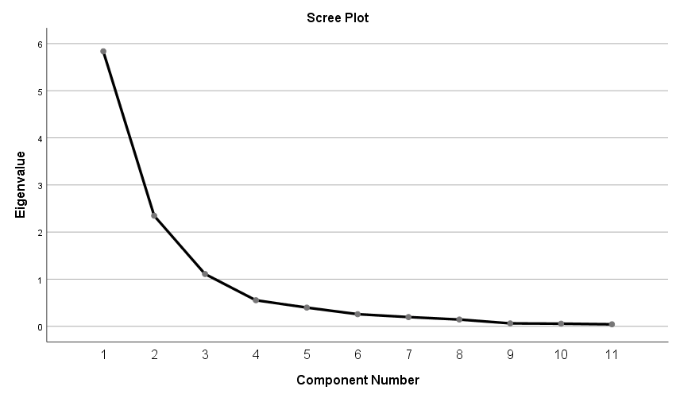
Principle Componenet Analysis

Slide 21
Principle Componenet Analysis

Slide 22
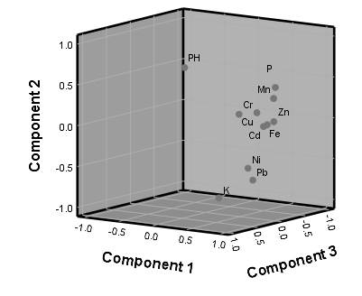
Principle Componenet Analysis

Slide 23
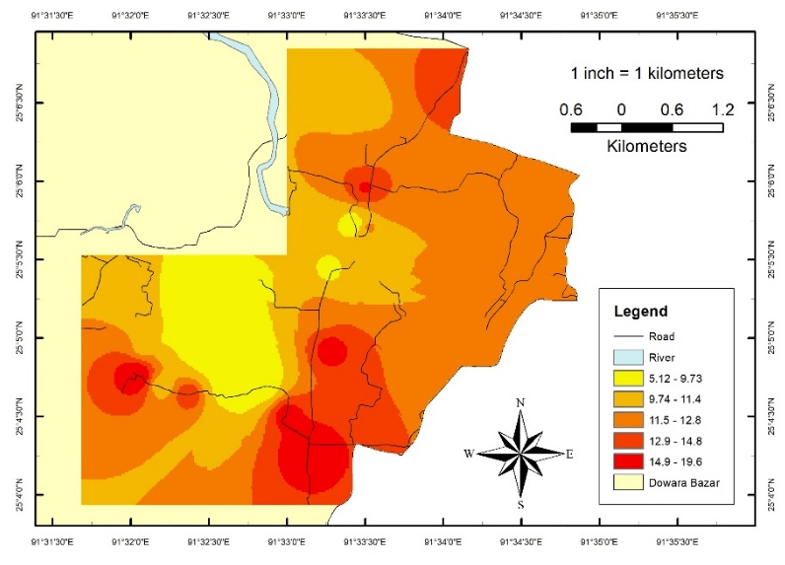
Metal Index
Extremely Affected
MI >6

Slide 24
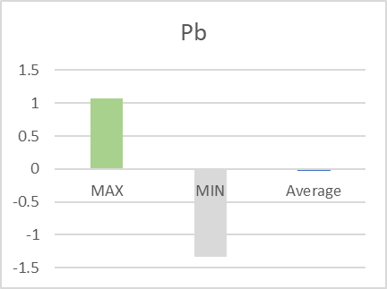
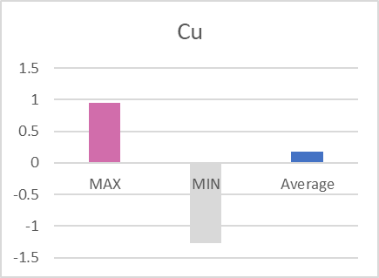
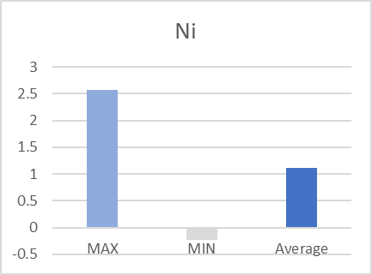
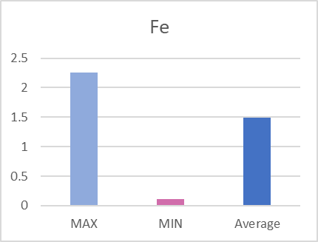
Geo- accumulation index

Slide 25
Pollution Index

Slide 26
Single Factor and Nemerow Comprehensive Index
Single factor Index
 | MAX | MIN | Average | Safe | Warning Line | Light | Moderate | Serious
Nemerow Comprehensive Index | 6.576672 | 1.45987 | 3.510403 | 0 | 0 | 2 | 8 | 13

Slide 27
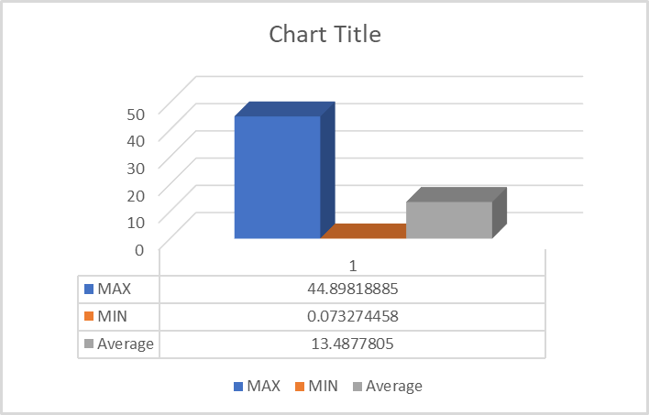
Pollution Load Index
Extremely High Polluted
PLI >16
No Pollution | Moderate Pollution | High and very Pollution | Extremely high Polluted
5 | 0 | 10 | 7

Slide 28
Conclusion
From the Study, the main conclusion is that can be as follows:
The soil samples showed a high concentration of heavy minerals. This phenomenon indicates that soil degradation.
Except Pb, Cu, Ni and Fe other heavy mineral value is in permissible limit. So the soil is recovering as there was agriculture around the blowout area or the flood help to dilute the concentration.
Here is an assumption that if the soil were collected before the flood, then it be a higher value for Pb, Cu, Ni and Fe.

